Slide 1
Chapter # Title Here PPT양식
4 January, 2021
IN HO SONG
mearrong123@gmail.com

Slide 2
Chapter Objectives
Introduction
단국대학교 최종무 교수님 연구실 커널 스터디에 오신것을 환영합니다.
Welcome to System Software Lab, Dankook University
Background
발표 목차는 다음과 같은 형식을 준수해주세요
Introduction/Background
Topic that I’ll present
Discussion
Conclusion/Summary
Topic
매주 화요일 스터디가 진행됩니다. 최소 월요일까지는 발표자료와 실습내용을 깃에 업로드 해주세요
Study begins every Tuesday
Please upload your presentation materials and practices at https://github.com/DKU-EmbeddedSystem-Lab/2021_Kernel_Study
Discussion
스터디는 국내/국외 논문, 저널 저술을 목표로 진행됩니다. 물론, 개인적인 공부도 좋습니다.
Summary
발표자료 이름은 “#주차_내용(가령, 리눅스 커널 전체 구조)_발표자.pptx”로 통일하겠습니다. 이후 PPT는 참고용 슬라이드입니다.
Also, please make sure that all ppt file’s names should be “#주차_내용_발표자”

Slide 3
Signals : Concepts
What is Signal ?
software interrupts.
Each signal is defined as a unique (small) integer, starting sequentially from 1.
defined in <signal.h> with symbolic names of the form SIGxxxx.

Slide 4
Signals : Concepts
One process can (if it has suitable permissions) send a signal to another process.
However, the usual source of many signals sent to a process is the kernel.
A Hardware exception occurred.(ex divide by 0)
User typed special characters that generate signals. (ex. ctrl^c)
A software event occurred.

Slide 5
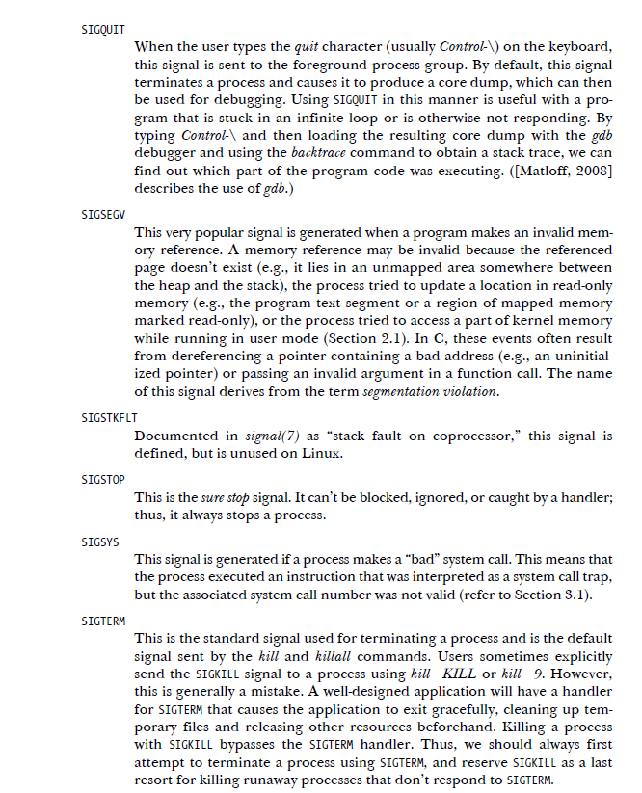
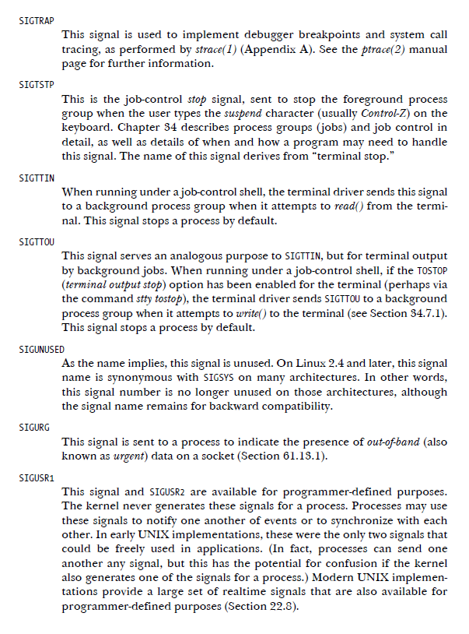
Signal Types and Default Actions

Slide 6
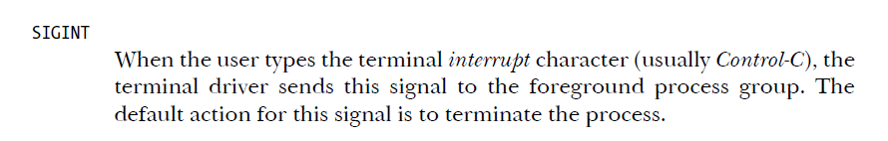
Signal Types and Default Actions
Various signals…
SIGINT
Signal occurs | When User types the terminal interrupt character. (Ctrl^c)
Default actions | expected to terminate the process

Slide 7
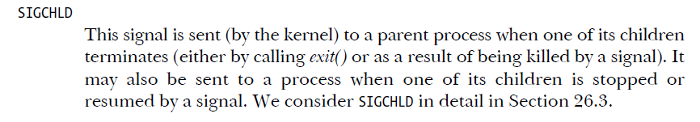
Signal Types and Default Actions
Various signals…
SIGCHLD
Signal occurs | When child process terminated or stopped.
Default actions | ignore signal.

Slide 8
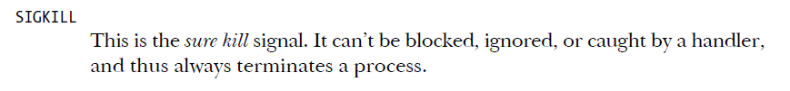
Signal Types and Default Actions
Various signals…
SIGKILL
actions | Always terminates a process.

Slide 9
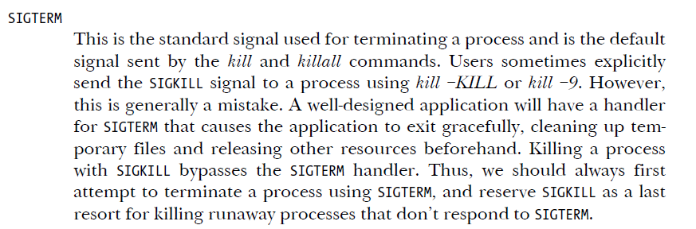
Signal Types and Default Actions
Various signals…
SIGTERM
Signal occurs | When SIGKILL occurs.
Default actions | cleaning up temporary files and other resource so that process can exit gracefully.

Slide 10
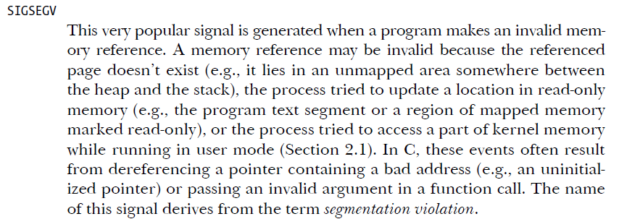
Signal Types and Default Actions
Various signals…
SIGSEV
Signal occurs | When process makes an invalid memory reference.
Default actions | Terminate process with a core dump.

Slide 11
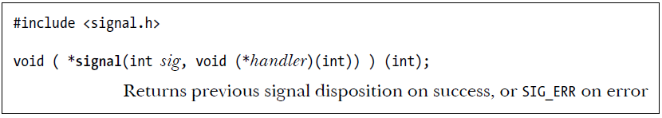
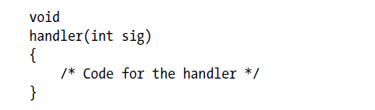
Changing Signal Dispositions
changing the disposition of a signal : signal() & sigaction()
Because of these portability issues, sigaction() is the (strongly) preferred API for establishing a signal handler.
SIG_DFL : default
Reset the disposition of the signal to its default.
Term : terminate
Ign : ignore sig
Core : terminate & core dump
Stop : stop
Cont : continue if stopped
SIG_IGN : ignore
Ignore the signal.
If the signal is generated for this process, the kernel silently discards it.
The process never even knows that the signal occurred.

Slide 12
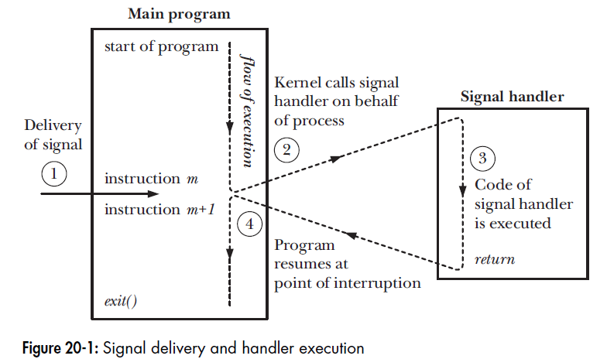
Signal Handler
Don’t call stdio function !!!

Slide 13
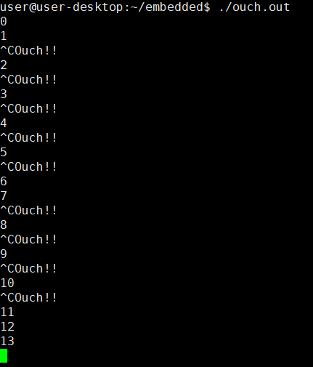
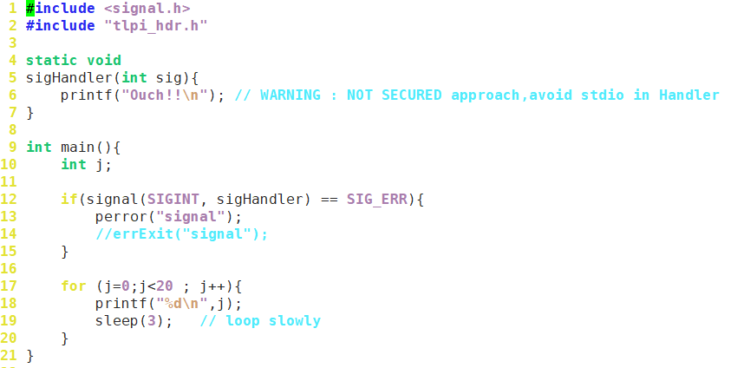
Signal Handler

Slide 14
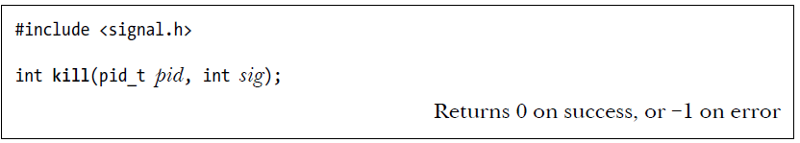
Sending Signals : process to process
Send signal to other process : kill()

Slide 15
Sending Signals : process to process
Send signal to other process : kill()
Case 1 : pid > 0
the signal is sent to the process.
(specified by pid)
Case 2 : pid == 0
the signal is sent to every process in the same process group as the calling process,
including the calling process itself.
Case 3 : pid < -1
the signal is sent to all of the processes in the process group
whose ID equals the absolute value of pid
Case 4 : pid == -1
the signal is sent to every process for which the calling process has permission to send a signal,
except init (process ID 1) and the calling process.
*If no process matches the specified pid, kill() fails and sets errno to ESRCH (“No such process”).

Slide 16
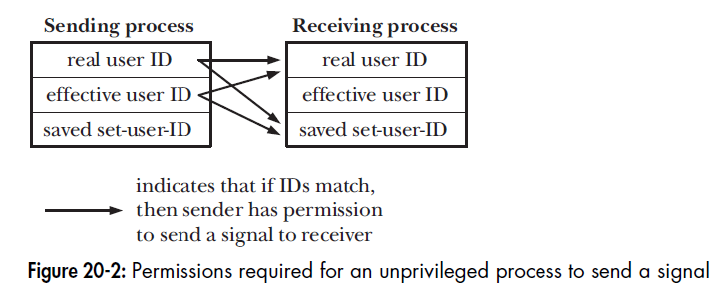
Sending Signals : process to process
A process needs appropriate permissions to be able send a signal to another process.
Case 1 : CAP_KILL
A privileged (CAP_KILL) process may send a signal to any process.
“ it prevents one user from sending signals to another user’s process that is running a set-user-ID program belonging to the user trying to send the signal ”
“.. 즉, 한 명의 사용자가 시그널을 보내려고 하는 사용자에 속한 set-user-ID프로그램을 실행 하고 있는 다른 사용자 프로세스에 시그널을 전달하는 것을 막는다.”
Case 2 : init process(PID =1)
This is a special case.
It can be sent only signals for which it has a handler installed.
Default :
An unprivileged process can send a signal to another process
if the real or effective user ID of the sending process matches the real user ID or
saved set-user-ID of the receiving process, as shown in Figure 20-2.
* SIGCONT signal is treated specially.

Slide 17
Checking for the Existence of a Process
The kill() system call can serve another purpose.
If the sig argument is specified as 0 (the so-called null signal), then no signal is sent.
Instead, kill() merely performs error checking to see if the process can be signaled.
ESRCH error!
→ process doesn’t exist
EPERM error!
→ process exist, but not authorized to send signal
Or Succeed
→ Process exist and be able to send signal

Slide 18
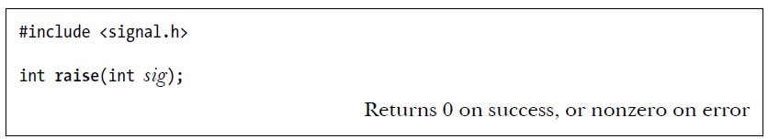
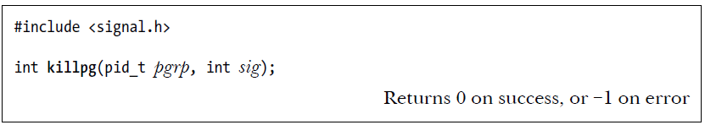
Other Ways of Sending Signals
raise() and killpg()

Slide 19
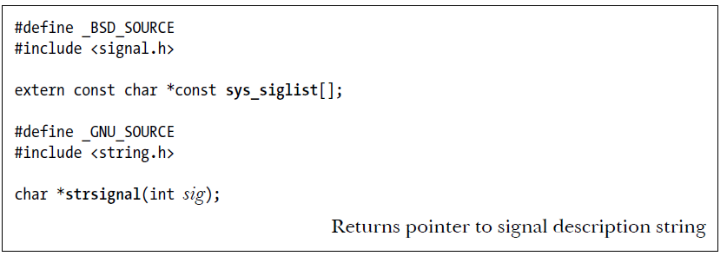
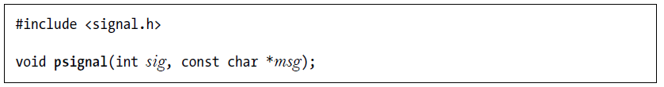
Displaying Signal Descriptions

Slide 20
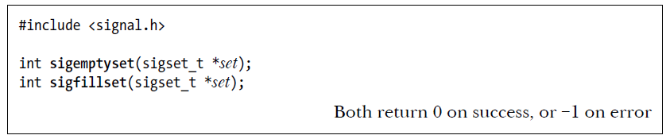
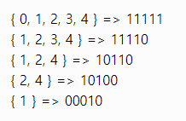
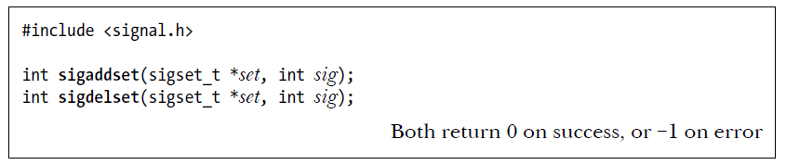
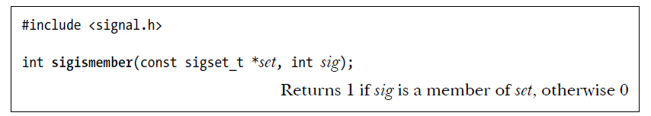
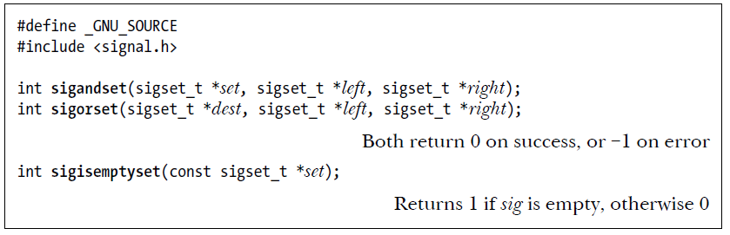
Signal Sets
sigset_t : a bit mask.
must be implemented using either some scalar type or a C structure
initialize signal set
Signal Set
Sigset_t (bitmaks)
Add/delete signal
Is signal is member?
BITMASK
GNU C library signals funcs
* the initialization of static variables to 0 can’t portably be relied upon as indicating an empty signal set, since signal
sets may be implemented using structures other than bit masks. (don’t use memset(3) also.)

Slide 21
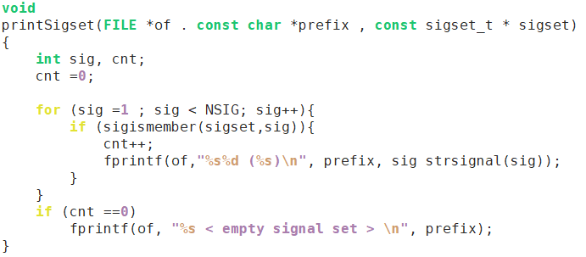
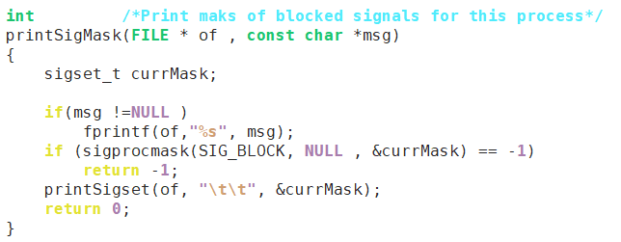
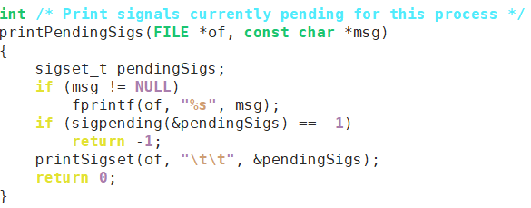
Signal Sets(9)
sigset_t : a bit mask.
must be implemented using either some scalar type or a C structure

Slide 22
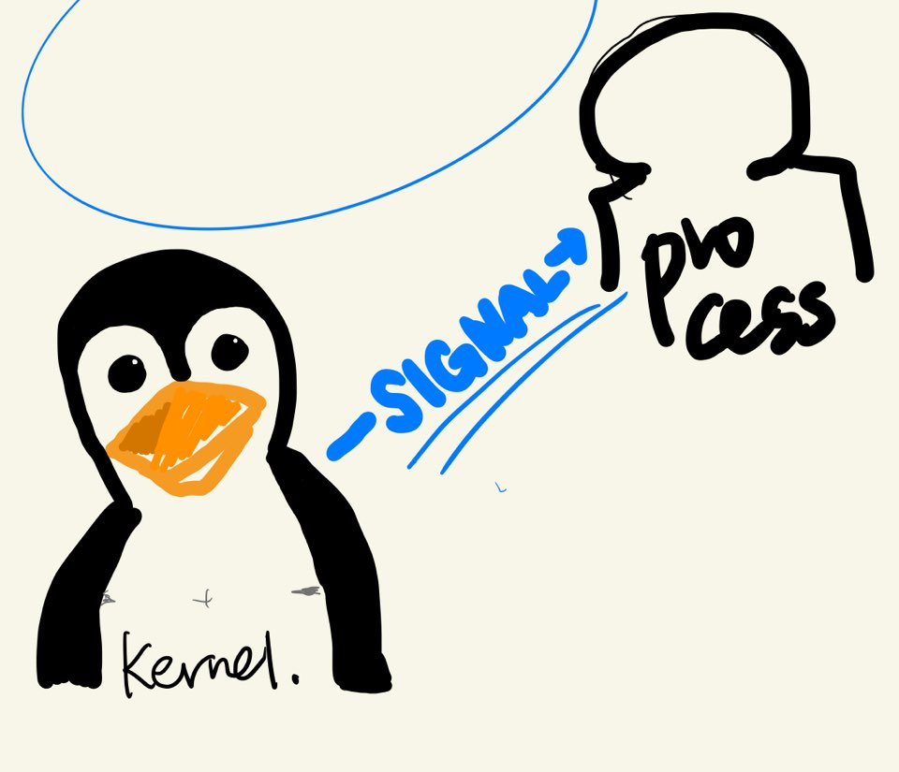
The Signal Mask
the kernel maintains a signal mask
signal mask : a set of signals whose delivery to the process is currently blocked.
Blocked signal
* If a signal that is blocked is sent to a process,
delivery of that signal is delayed until it is unblocked by being removed from the
process signal mask.
Block :{ signal ~~}
{ /* signal mask*/ }

Slide 23
The Signal Mask
When a signal handler is invoked,
the signal that caused its invocation can be
automatically added to the signal mask.
Whether or not this occurs depends on the flags used when the handler is established using sigaction().
{ /* signal mask*/ }
When a signal handler is established with sigaction(),
it is possible to specify an additional set of signals that are to be blocked when the handler is invoked.
The sigprocmask() system call
can be used at any time to explicitly add signals to, and remove signals from, the signal mask.

Slide 24
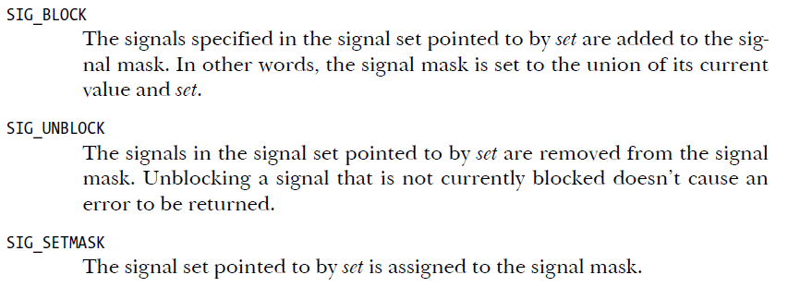
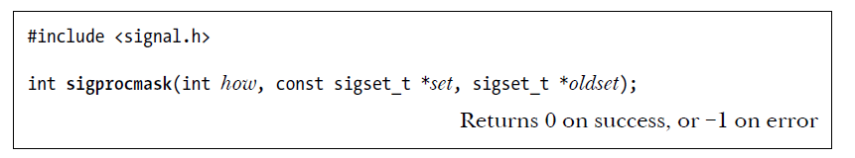
The Signal Mask
We can use sigprocmask()
to change the process signal mask,
to retrieve the existing mask,
or both.
{ /* signal mask*/ }
specified signal set
Previous signal mask
Any attempts to block the SIGKILL and SIGSTOP are silently ignored
If we unblock a pending signal, it is delivered to the process immediately
If we want to retrieve the signal mask without changing it, then we can specify NULL
for the set argument.(then how arg is ignored)

Slide 25
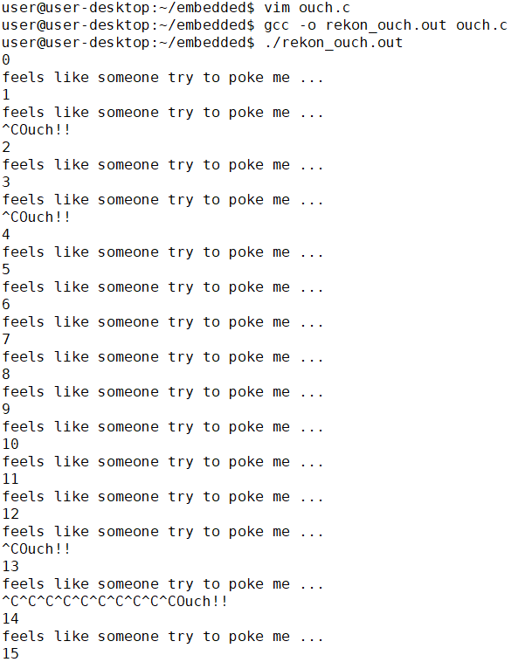
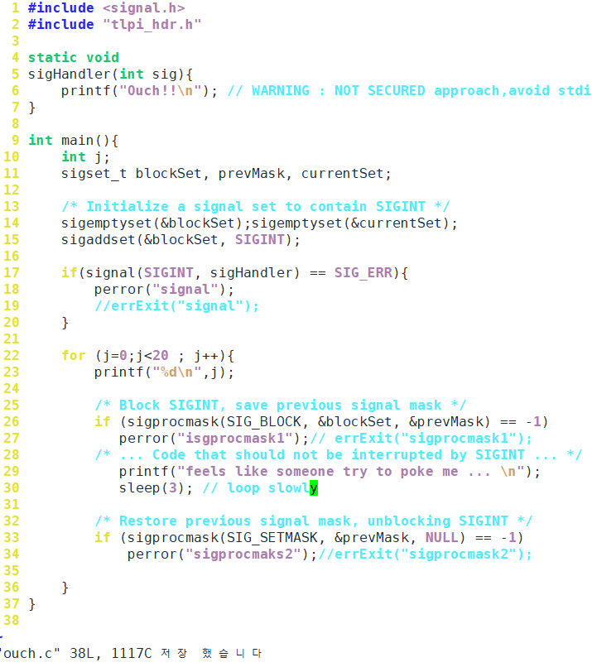
The Signal Mask(10)

Slide 26
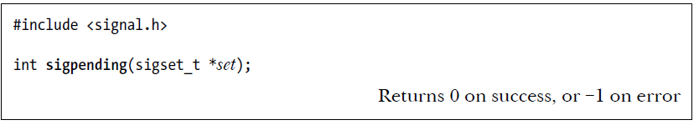
Pending Signals
To determine which signals are pending for a process, we can call sigpending().
If we change the disposition of a pending signal, then, when the signal is later unblocked, it is handled according to its new disposition.
If we change settings pending signals(set) disposition to SIG_IGN or SIG_DFL, then pending signals will be ignored.

Slide 27
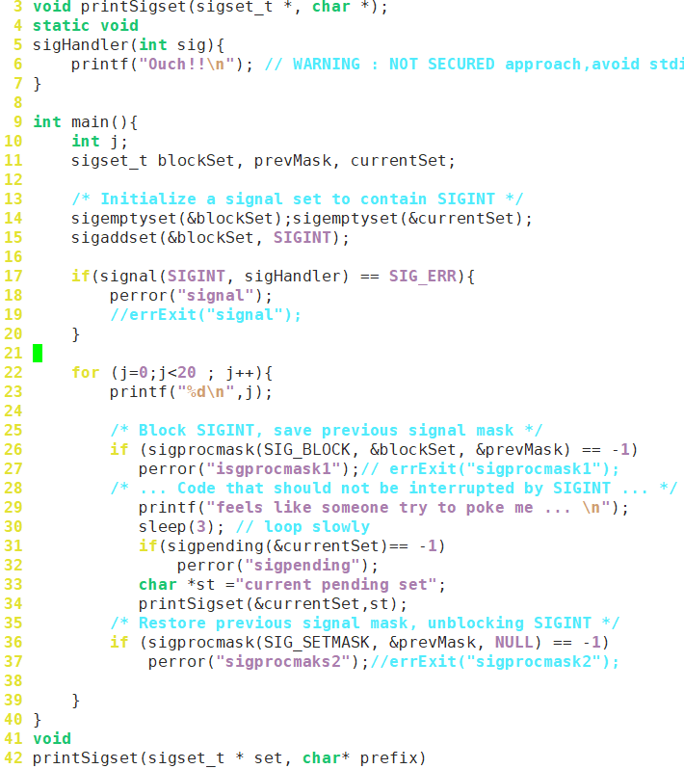
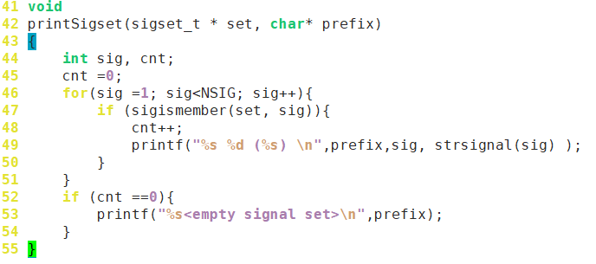
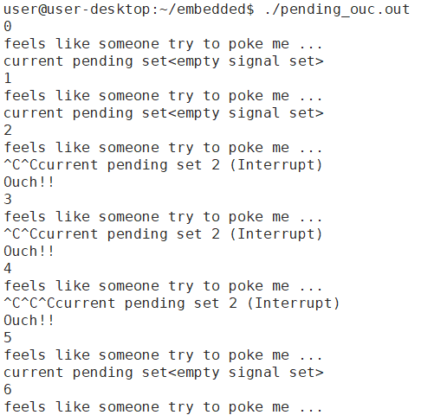
Pending Signals(11)

Slide 28
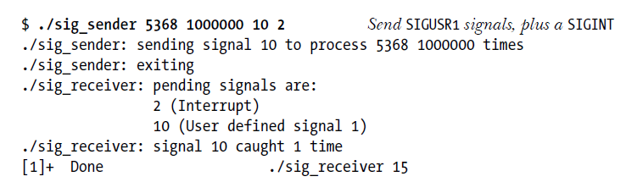
Signals Are Not Queued
The set of pending signals is only a mask;
if the same signal is generated multiple times while it is blocked
-> later delivered, just once.

Slide 29
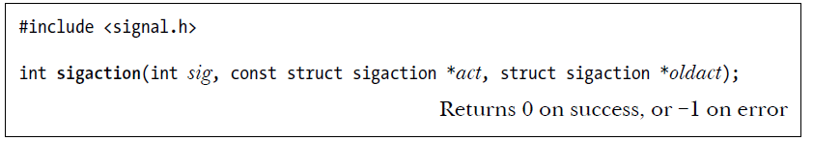
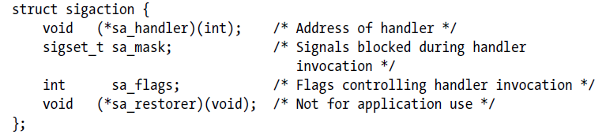
Changing Signal Dispositions: sigaction()
sigaction() : more complex to use than signal(), in return it provides greater flexibility. (especially more potable establishing a signal handler)
시그널
I. 시그널의 새로운 속성정보
II. 시그널의 이전 속성정보
*Address of signal handler
SIG_DFL or SIG_IGN
a set of signals that are to be blocked (during invocation of the handler)
bit mask specifying various options controlling how the signal is handled.

Slide 30
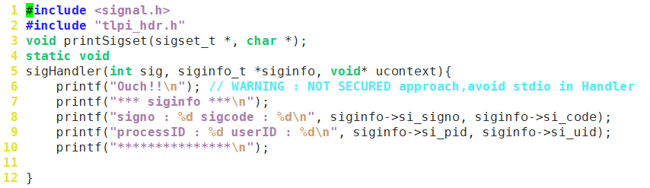
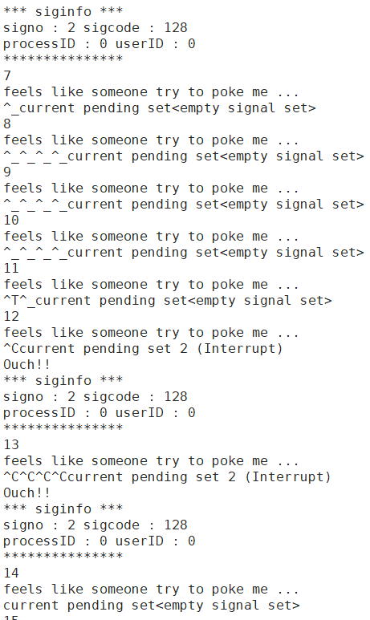
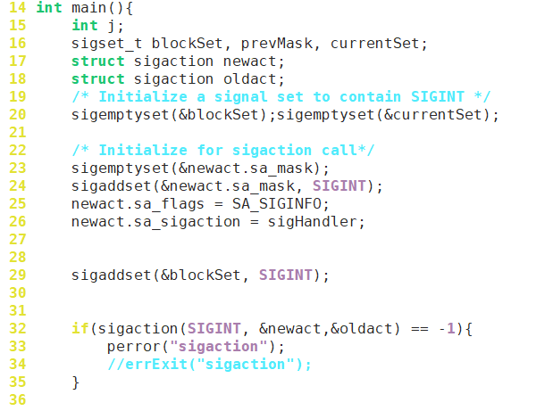
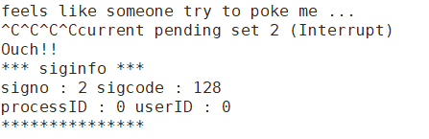
Changing Signal Dispositions : sigaction()

Slide 31
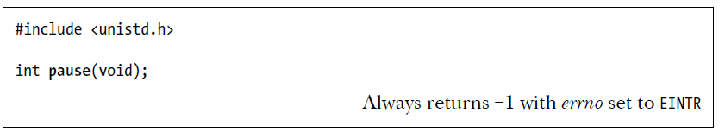
Waiting for a Signal
pause() : suspends execution of the process
(until the call is interrupted by a signal handler)

Slide 32
Summary
A signal is a notification that some kind of event has occurred.
and may be sent to a process by kernel, by another process, or by itself.
By default, a signal either is ignored, terminates a process, stops a running process, or restarts a stopped process.
Can change signal action by using signal() or sigaction()
Use kill() to send signal to other process
NULL signal(0) means check pid whether it is using or not.
Each process has signal mask.
it can change by sigprocmask()
If signal blocked, then it remains “pending” till unblocked.
To see pending signals, sigpending()
pause() : suspends execution of the process (until the call is interrupted by a signal handler)

Slide 33
Q & A

